Slide 1
EECS 373
Design of Microprocessor-Based Systems
Prabal Dutta
University of Michigan
Lecture 4: Review, Simulation, ABI, and Memory-Mapped I/O
September 15, 2011

Slide 2
Announcements
Homework 1 to be posted
  ARM Cortex Simulator
  Will test low-level understanding
  Intentionally poorly specified, but see:
  http://www.eecs.umich.edu/~prabal/teaching/eecs373-f11/roadmap.html
  Use the class email list for questions, discussion
  Discuss with classmates
  Think through solutions before looking at others code
  Get started early! Your classmates will be depending on you!

Slide 3
Outline
Minute quiz
Announcements
Review
Assembly, C, and the ABI
Memory
Memory-mapped I/O

Slide 4
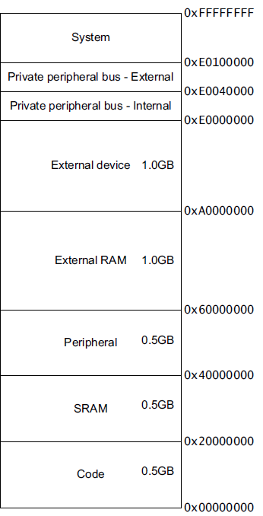
What happens after a power-on-reset (POR)?
On the ARM Cortex-M3
SP and PC are loaded from the code (.text) segment
Initial stack pointer
  LOC: 0x00000000
  POR: SP ← mem(0x00000000)
Interrupt vector table
  Initial base: 0x00000004
  Vector table is relocatable
  Entries: 32-bit values
  Each entry is an address
  Entry #1: reset vector
    LOC: 0x0000004
    POR: PC ← mem(0x00000004)
Execution begins
.equ STACK_TOP, 0x20000800
.text
.syntax unified
.thumb
.global _start
.type start, %function
_start:
.word STACK_TOP, start
start:
movs r0, #10
...

Slide 5
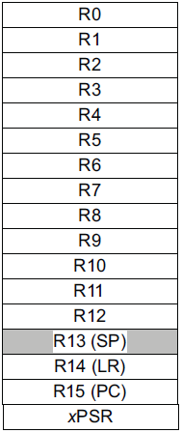
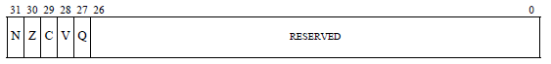
Major elements of an Instruction Set Architecture
(registers, memory, word size, endianess, conditions, instructions, addressing modes)
32-bits
32-bits
mov r0, #1
ld r1, [r0,#5]
mem((r0)+5)
bne loop
subs r2, #1
Endianess
Endianess

Slide 6
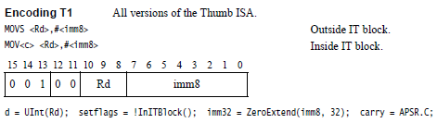
Instruction encoding
Instructions are encoded in machine language opcodes
Sometimes
  Distinguish opcodes from each other
  Necessary to decode opcodes and itemize arch state impacts
How?
Instructions
movs r0, #10
movs r1, #0
Register Value Memory Value
001|00|000|00001010 (LSB) (MSB)
(msb) (lsb) 0a 20 00 21
001|00|001|00000000
ARMv7 ARM
Notes:
Condition codes are simply a way of testing the ALU status flags.

Slide 7
Instruction encoding/decoding
Thumb instructions are a sequence of half-word-aligned half-words
Each Thumb instruction is either
  a 16-bit half-word in that stream
  A 32-bit instruction consisting of two half-words in that stream
If bits [15:11] of the half-word being decoded take on any of the following values
  0b11101
  0b11110
  0b11111
  then half-word is the first half-word of a 32-bit instruction
  otherwise the half-word is a 16-bit instruction
See ARM ARM A5.1, A5.5, A5-13
Notes:
Condition codes are simply a way of testing the ALU status flags.

Slide 8
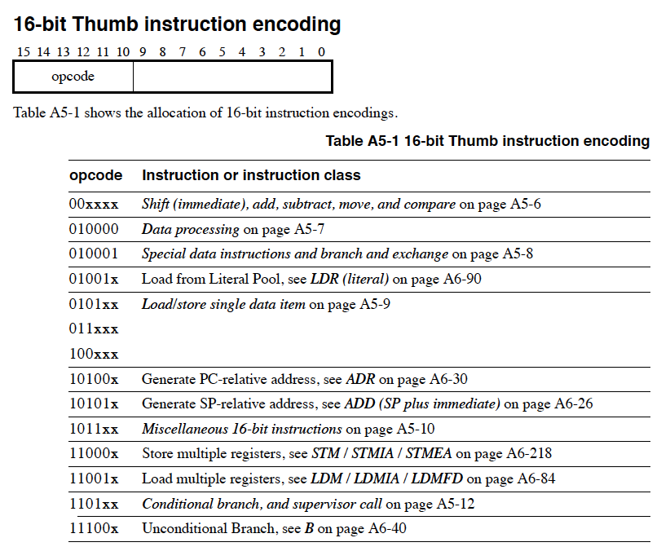
Instruction encoding/decoding (class-level)
Notes:
Condition codes are simply a way of testing the ALU status flags.

Slide 9
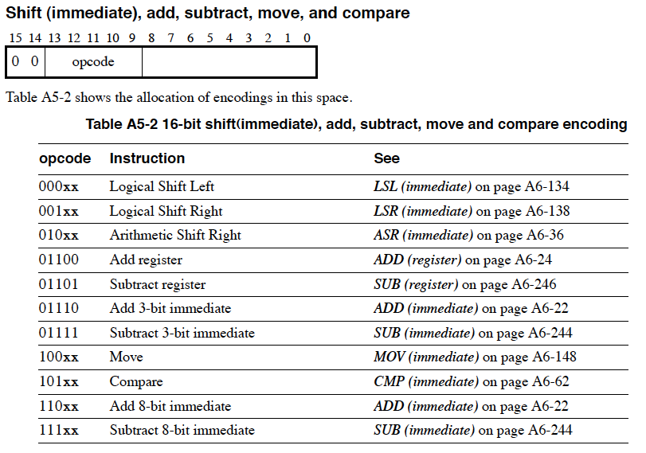
Instruction encoding/decoding (instruction-level)
Notes:
Condition codes are simply a way of testing the ALU status flags.

Slide 10
Linker script
OUTPUT_FORMAT("elf32-littlearm")
OUTPUT_ARCH(arm)
ENTRY(main)
MEMORY
{
/* SmartFusion internal eSRAM */
ram (rwx) : ORIGIN = 0x20000000, LENGTH = 64k
}
SECTIONS
{
.text :
{
. = ALIGN(4);
*(.text*)
. = ALIGN(4);
_etext = .;
} >ram
}
end = .;
Specifies little-endian arm in ELF format.
Specifies ARM CPU
Should start executing at label named “main”
We have 64k of memory starting at 0x20000000. You can read (r), write (w) and execute (x) out of it. We’ve named it “ram”
“.” is a reference to the current memory location
First align to a word (4 byte) boundry
Place all sections that include .text at the start (* here is a wildcard)
Define a label named _etext to be the current address.
Put it all in the memory location defined by the ram memory location.

Slide 11
Some things to think about (TTTA)
What instruction set? Thumb!
What is conditional execution (ARM ARM, A4.1.2)?
What are the side effects of instruction execution?

Slide 12
How does an assembly language program get turned into a executable program image?
Binary program
file (.bin)
Assembly
files (.s)
Object
files (.o)
Executable
image file
objcopy
ld
(linker)
as
(assembler)
objdump
Memory
layout
Disassembled
code (.lst)
Linker
script (.ld)

Slide 13
Outline
Minute quiz
Announcements
Review
Assembly, C, and the ABI
Memory
Memory-mapped I/O

Slide 14
Cheap trick: use asm() or __asm() macros to sprinkle simple assembly in standard C code!
int main() {
int i;
int n;
unsigned int input = 40, output = 0;
for (i = 0; i < 10; ++i) {
n = factorial(i);
printf("factorial(%d) = %d\n", i, n);
}
__asm("nop\n");
__asm("mov r0, %0\n"
"mov r3, #5\n"
"udiv r0, r0, r3\n"
"mov %1, r0\n"
:"=r" (output)
: "r" (input)
: "cc", "r3" );
__asm("nop\n");
printf("%d\n", output);
}
$ arm-none-eabi-gcc \
-mcpu=cortex-m3 \
-mthumb main.c \
-T generic-hosted.ld \
-o factorial
$ qemu-arm -cpu cortex-m3 \
./factorial
factorial(0) = 1
factorial(1) = 1
factorial(2) = 2
factorial(3) = 6
factorial(4) = 24
factorial(5) = 120
factorial(6) = 720
factorial(7) = 5040
factorial(8) = 40320
factorial(9) = 362880
8
Answer: 40/5 →

Slide 15
How does a mixed C/Assembly program get turned into a executable program image?
C files (.c)
Binary program
file (.bin)
ld
(linker)
Assembly
files (.s)
Object
files (.o)
Executable
image file
objcopy
gcc
(compile
+ link)
as
(assembler)
objdump
Memory
layout
Disassembled
Code (.lst)
Library object
files (.o)
Linker
script (.ld)

Slide 16
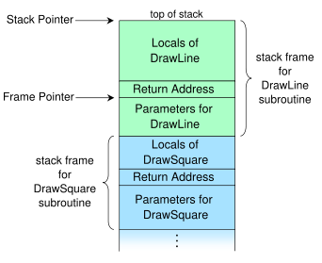
Passing parameters via the stack
Benefits?
Drawbacks?

Slide 17
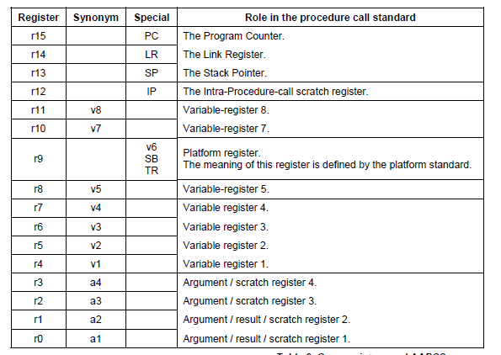
Passing parameters via the registers/stack

Slide 18
ABI Basic Rules
A subroutine must preserve the contents of the registers r4-r11 and SP
Arguments are passed though r0 to r3
  If we need more, we put a pointer into memory in one of the registers.
    We’ll worry about that later.
Return value is placed in r0
  r0 and r1 if 64-bits.
Allocate space on stack as needed. Use it as needed.
  Put it back when done…
  Keep word aligned.

Slide 19
Other useful facts
Stack grows down.
  And pointed to by “SP”
Address we need to go back to in “LR”
And useful things for the example
Assembly instructions
  add adds two values
  mul multiplies two values
  bx branch to register

Slide 20
A simple ABI routine
int bob(int a, int b)
  returns a² + b²
Instructions you might need
  add adds two values
  mul multiplies two values
  bx branch to register

Slide 21
Same thing, but for no good reason using the stack
int bob(int a, int b)
  returns a² + b²

Slide 22
Some disassembly
0x20000490 <bob>: push {r7}
0x20000492 <bob+2>: sub sp, #20
0x20000494 <bob+4>: add r7, sp, #0
0x20000496 <bob+6>: str r0, [r7, #4]
0x20000498 <bob+8>: str r1, [r7, #0]
x=a*a;
0x2000049a <bob+10>: ldr r3, [r7, #4]
0x2000049c <bob+12>: ldr r2, [r7, #4]
0x2000049e <bob+14>: mul.w r3, r2, r3
0x200004a2 <bob+18>: str r3, [r7, #8]
y=b*b;
0x200004a4 <bob+20>: ldr r3, [r7, #0]
0x200004a6 <bob+22>: ldr r2, [r7, #0]
0x200004a8 <bob+24>: mul.w r3, r2, r3
0x
x=x+y;
0x200004ae <bob+30>: ldr r2, [r7, #8]
0x200004b0 <bob+32>: ldr r3, [r7, #12]
0x200004b2 <bob+34>: add r3, r2
0x200004b4 <bob+36>: str r3, [r7, #8]
0x200004ac <bob+28>: str r3, [r7, #12]
return(x);
0x200004b6 <bob+38>: ldr r3, [r7, #8]
}
0x200004b8 <bob+40>: mov r0, r3
0x200004ba <bob+42>: add.w r7, r7, #20
0x200004be <bob+46>: mov sp, r7
0x200004c0 <bob+48>: pop {r7}
0x200004c2 <bob+50>: bx lr
int bob(int a, int b)
{
int x, y;
x=a*a;
y=b*b;
x=x+y;
return(x);
}

Slide 23
Outline
Minute quiz
Announcements
Review
Assembly, C, and the ABI
Memory
Memory-mapped I/O

Slide 24
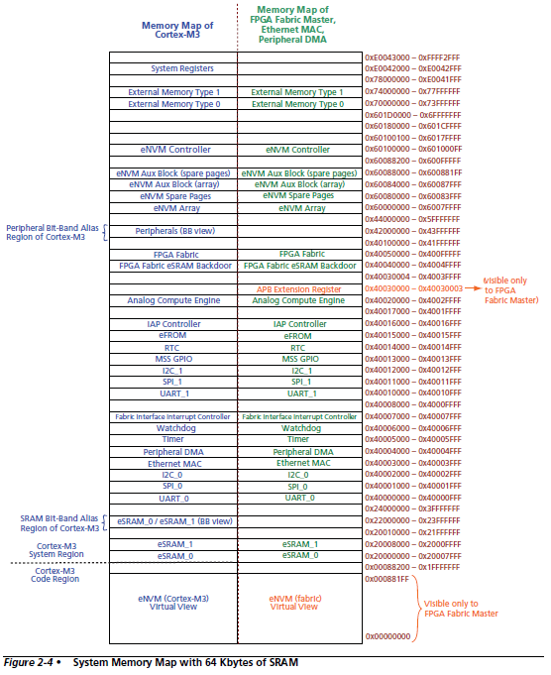
System
Memory
Map
Notes:
Condition codes are simply a way of testing the ALU status flags.

Slide 25
Outline
Minute quiz
Announcements
Review
Assembly, C, and the ABI
Memory
Memory-mapped I/O

Slide 26
Memory-mapped I/O
The idea is really simple
  Instead of real memory at a given memory address, have an I/O device respond.
Example:
  Let’s say we want to have an LED turn on if we write a “1” to memory location 5.
  Further, let’s have a button we can read (pushed or unpushed) by reading address 4.
    If pushed, it returns a 1.
    If not pushed, it returns a 0.

Slide 27
Now…
How do you get that to happen?
  We could just say “magic” but that’s not very helpful.
  Let’s start by detailing a simple bus and hooking hardware up to it.
We’ll work on a real bus next time!

Slide 28
Basic example
Discuss a basic bus protocol
  Asynchronous (no clock)
  Initiator and Target
  REQ#, ACK#, Data[7:0], ADS[7:0], CMD
    CMD=0 is read, CMD=1 is write.
    REQ# low means initiator is requesting something.
    ACK# low means target has done its job.

Slide 29
A read transaction
Say initiator wants to read location 0x24
  Initiator sets ADS=0x24, CMD=0.
  Initiator then sets REQ# to low. (why do we need a delay? How much of a delay?)
  Target sees read request.
  Target drives data onto data bus.
  Target then sets ACK# to low.
  Initiator grabs the data from the data bus.
  Initiator sets REQ# to high, stops driving ADS and CMD
  Target stops driving data, sets ACK# to high terminating the transaction

Slide 30
Read transaction
ADS[7:0]
CMD
Data[7:0]
REQ#
ACK#
??
0x24
??
??
0x55
??
A B C D E F G HI

Slide 31
A write transaction
(write 0xF4 to location 0x31)
  Initiator sets ADS=0x31, CMD=1, Data=0xF4
  Initiator then sets REQ# to low.
  Target sees write request.
  Target reads data from data bus. (Just has to store in a register, need not write all the way to memory!)
  Target then sets ACK# to low.
  Initiator sets REQ# to high & stops driving other lines.
  Target sets ACK# to high terminating the transaction

Slide 32
The push-button
(if ADS=0x04 write 0 or 1 depending on button)
ADS[7]
ADS[6]
ADS[5]
Delay
ACK#
ADS[4]
ADS[3]
ADS[2]
ADS[1]
ADS[0]
Data[7]
REQ#
..
..
..
..
..
0
Button (0 or 1)
Data[0]
Button (0 or 1)

Slide 33
The push-button
(if ADS=0x04 write 0 or 1 depending on button)
ADS[7]
ADS[6]
ADS[5]
Delay
ACK#
ADS[4]
ADS[3]
ADS[2]
ADS[1]
ADS[0]
Data[7]
REQ#
..
..
..
..
..
0
What about CMD?
Data[0]
Button (0 or 1)

Slide 34
The LED
(1 bit reg written by LSB of address 0x05)
ADS[7]
ADS[6]
ADS[5]
Delay
ACK#
ADS[4]
ADS[3]
ADS[2]
ADS[1]
ADS[0]
Flip-flop which controls LED
D
REQ#
clock
DATA[7]
DATA[6]
DATA[5]
DATA[4]
DATA[3]
DATA[2]
DATA[1]
DATA[0]

Slide 35
Basic example
Discuss a basic bus protocol
  Asynchronous (no clock)
  Initiator and Target
  REQ#, ACK#, Data[7:0], ADS[7:0], CMD
    CMD=0 is read, CMD=1 is write.
    REQ# low means initiator is requesting something.
    ACK# low means target has done its job.

Slide 36
A read transaction
Say initiator wants to read location 0x24
  Initiator sets ADS=0x24, CMD=0.
  Initiator then sets REQ# to low. (why do we need a delay? How much of a delay?)
  Target sees read request.
  Target drives data onto data bus.
  Target then sets ACK# to low.
  Initiator grabs the data from the data bus.
  Initiator sets REQ# to high, stops driving ADS and CMD
  Target stops driving data, sets ACK# to high terminating the transaction

Slide 37
Read transaction
ADS[7:0]
CMD
Data[7:0]
REQ#
ACK#
??
0x24
??
??
0x55
??
A B C D E F G HI

Slide 38
A write transaction
(write 0xF4 to location 0x31)
  Initiator sets ADS=0x31, CMD=1, Data=0xF4
  Initiator then sets REQ# to low.
  Target sees write request.
  Target reads data from data bus. (Just has to store in a register, need not write all the way to memory!)
  Target then sets ACK# to low.
  Initiator sets REQ# to high & stops driving other lines.
  Target sets ACK# to high terminating the transaction

Slide 39
The push-button
(if ADS=0x04 write 0 or 1 depending on button)
ADS[7]
ADS[6]
ADS[5]
Delay
ACK#
ADS[4]
ADS[3]
ADS[2]
ADS[1]
ADS[0]
Data[7]
REQ#
..
..
..
..
..
0
Button (0 or 1)
Data[0]
Button (0 or 1)

Slide 40
The push-button
(if ADS=0x04 write 0 or 1 depending on button)
ADS[7]
ADS[6]
ADS[5]
Delay
ACK#
ADS[4]
ADS[3]
ADS[2]
ADS[1]
ADS[0]
Data[7]
REQ#
..
..
..
..
..
0
What about CMD?
Data[0]
Button (0 or 1)

Slide 41
The LED
(1 bit reg written by LSB of address 0x05)
ADS[7]
ADS[6]
ADS[5]
Delay
ACK#
ADS[4]
ADS[3]
ADS[2]
ADS[1]
ADS[0]
Flip-flop which controls LED
D
REQ#
clock
DATA[7]
DATA[6]
DATA[5]
DATA[4]
DATA[3]
DATA[2]
DATA[1]
DATA[0]

Slide 42
Questions?
Comments?
Discussion?

